Slide 1
Paranoia
Himnish Nanda, Mo

Slide 2
What is this game about?
It's a survival/horror - first person
Since it mostly focuses on psychology and play of the mind we opted to go more of the exploratory route.
It's about an investigation against an organisation which involes the investigator aka Ben having a serious car. He then must explore through the hospital, regain all the events leading up to the moment and stop the culprit.

Slide 3
Themes
Survival/Horror
Psychology
Trust and guilt
Detection
Notes:
Survival horror – the whole character is having to survive from monsters
Psychology – the whole game revolves around the player aka Ben having his mind being played
Trust – this game has many plot twists which allows the player to question who he/she should trust
Guilt – Ben experiences guilt for supposedly losing his family and that guilt will grow bigger as the game progresses
Detection – The game revolves around investigating several things, e.g. a car crash that led you here and everything before it

Slide 4


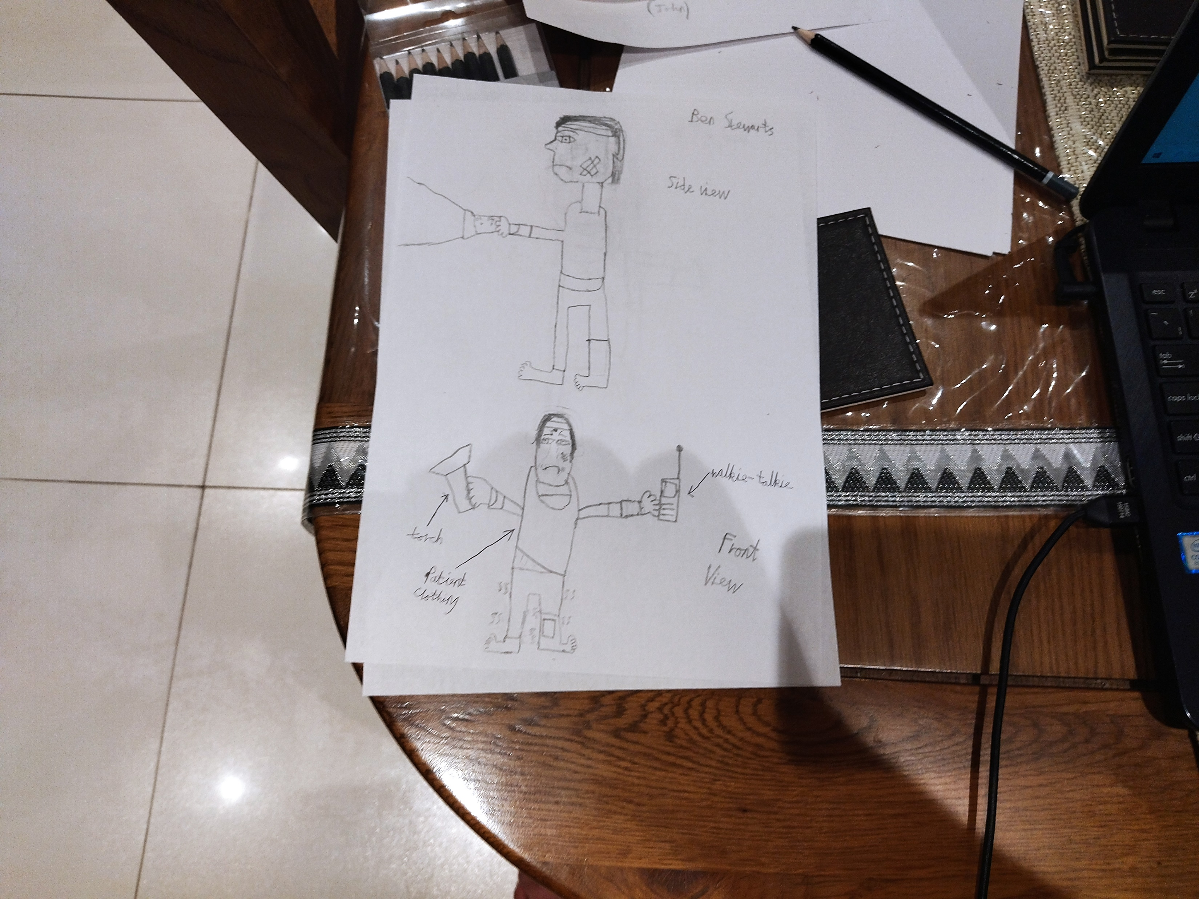

Ben Stewarts - Who is he?
A police officer - investigating an organisation - got a car crash - lost family
Age: 27
Endgame: to expose antagonist and organisation
Family: wife and two kids
Notes:
Ben Stewarts – can remember the car accident but can’t remember anything before it
He was set to investigate a case on a sketchy organisation that leads to the crash
He gets a mental breakdown after taking spiked medicine

Slide 5
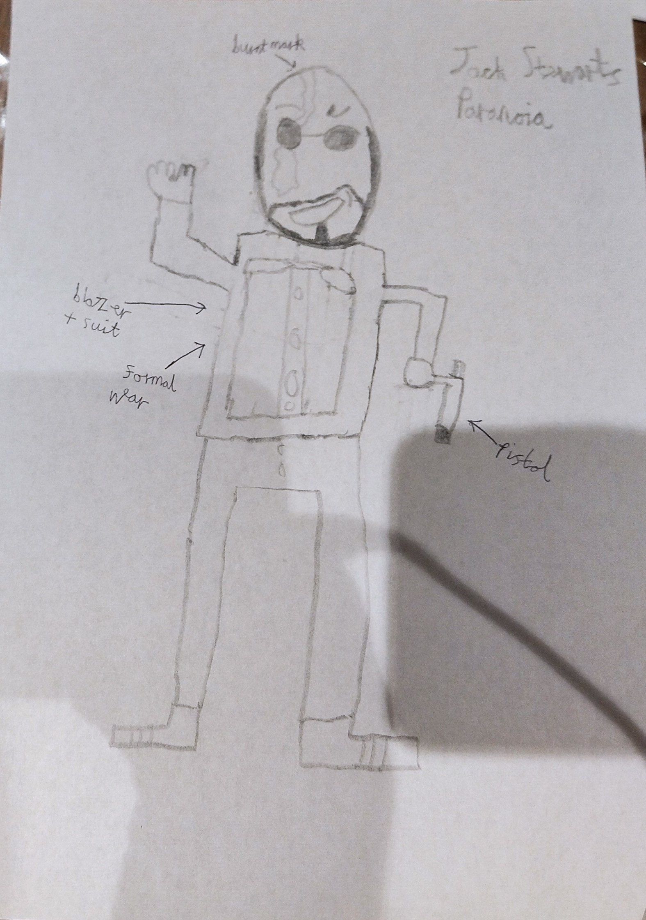
Main Antagonist - Jack Stewarts
Ben's biological brother
Age: 26
Was once a police officer, unfortunately in a mission caught himself in a burning house and disappeared. After that he got wrapped up in being the main head of the Bio Evolution corp. and maniplutes everyone.
Notes:
Jack and Ben were both raised in an orphanage

Slide 6
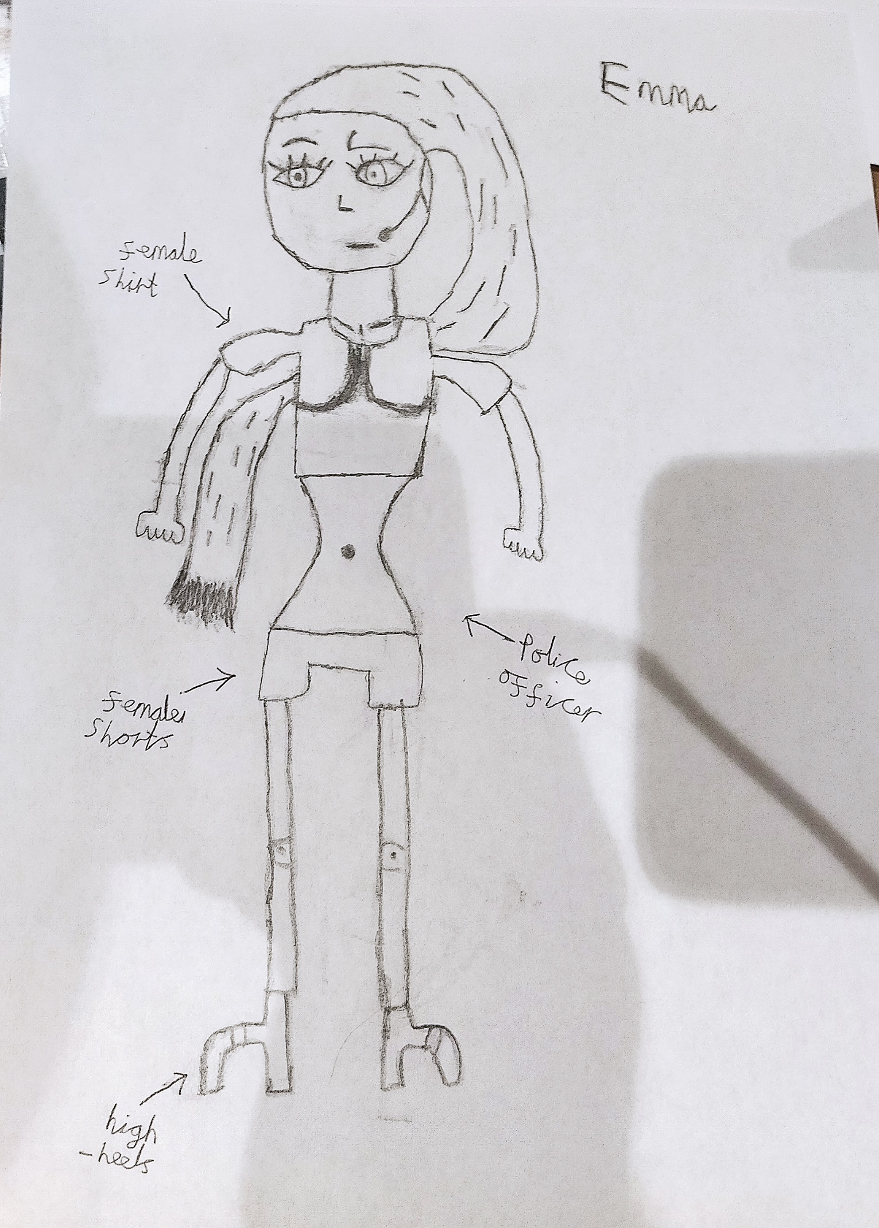
Emma - Secret Protagonist
Age: 27
Occupation: police officer
Background history: Was involved in many cases with Ben and was once his girlfriend before they broke up due to personal reasoning.

Slide 7
Hospital
This hospital is well renounced for its professional care towards patients with severe injuries
However, with every professional places, it has some dark secrets of its own. Investigate thoroughly to find out the truth between the hospital and this case.

Slide 8
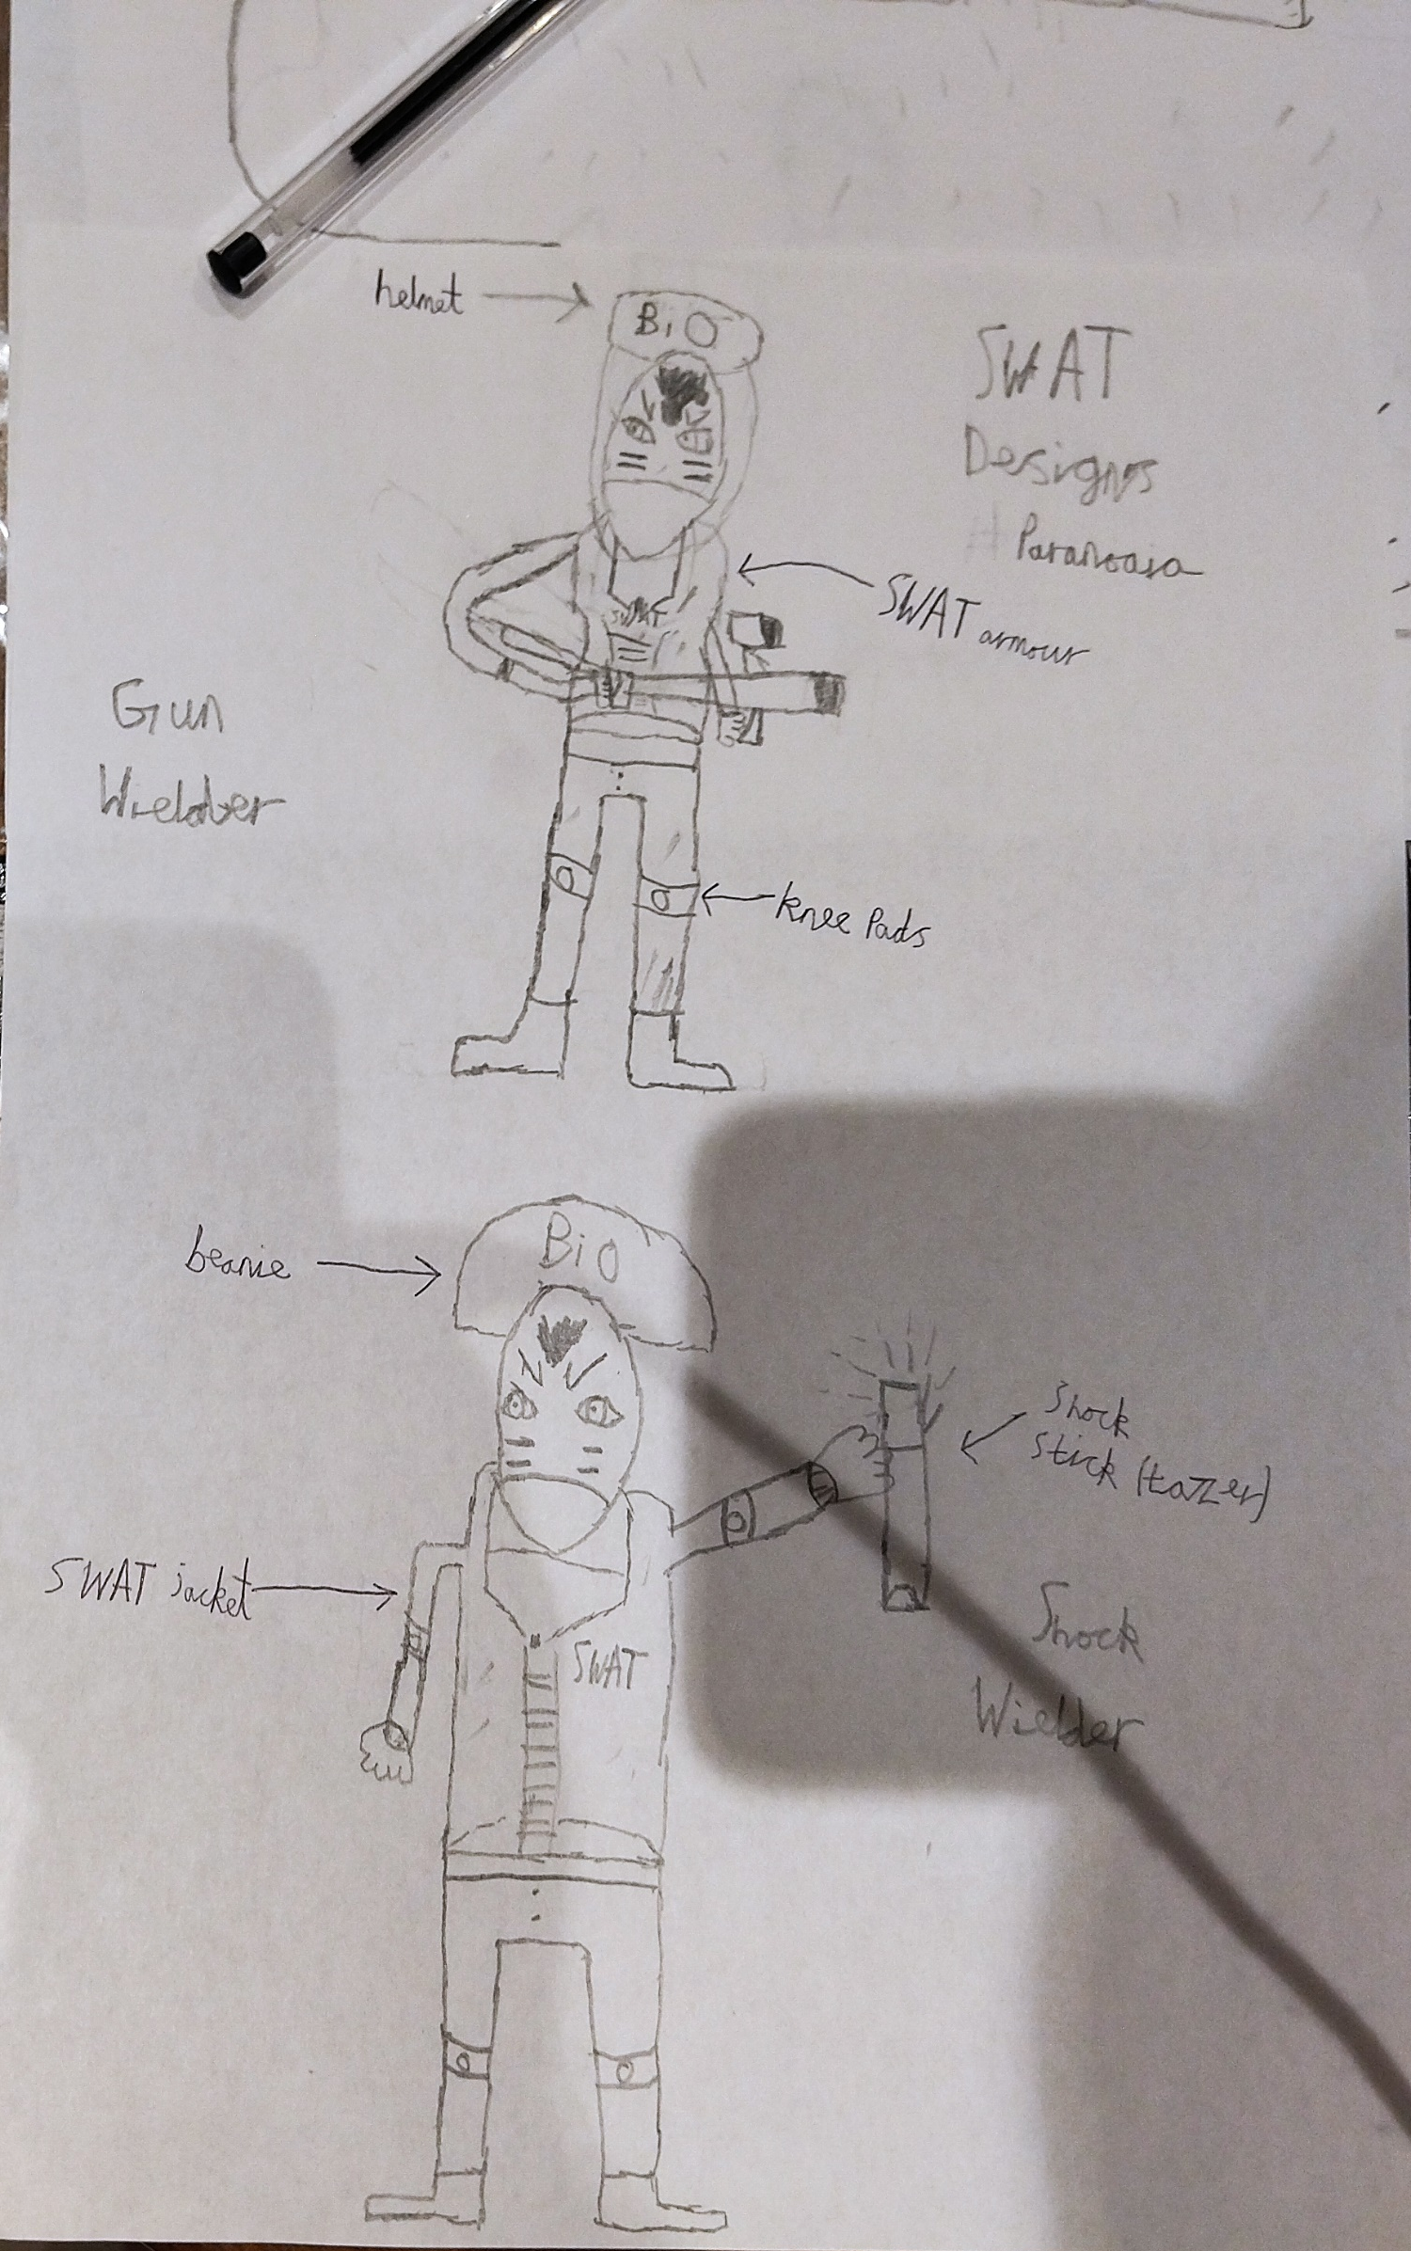
The Bio Evolution Corp.
This company is involved with creating new biological revolutions every time.
However, Ben discovers this company is involved in extreme and unethical practices with their workers + volunteer. As Ben finds important evidence, they try to blow up his car to silence him.
Investigate and expose their secrets to the entire world.

Slide 9
Story Narrative
We see Ben and his family drive off, suddenly they get into a car crash.
Months pass by and Ben regains conscious, unable to remember the events leading up to the crash.
When taking his medicine, Ben suddenly starts to mentally break down and Doctor’s put in sedative to make Ben unconscious. Ben suddenly wakes up in the basement. (game starts)

Slide 10
Story Narrative 2
When Ben gets out of the basements, he hears roaring. Ben sees a creature coming towards him and proceeds to run in terror.
He finds a broken glass and stabs the creature who immediately proceeds to fall unconscious.
Ben finds a walkie talkie that was being held by the creature. He gets in on a mysterious conversation with a secret protagonist.

Slide 11
Story Narrative 3
Upon reaching the ground floor, Ben investigates the R + D zones to see the effects of the medicine. He noticed that the effects of the medicine he took on that day are different to the actual effects of the medicine. This had meant that someone had tampered with his medicine.
Upon walking through the corridors, Ben notices a vague shadow. Ben starts to follow it and a tune starts to play. Suddenly, he starts to experience a mental breakdown. Within his mental breakdown, he starts to experience memories of his family, ending with a dark hooded figure.

Slide 12
Story Narrative 4
Ben regains consciousness and gets another call from this "secret protagonist" and asks how his breakdown experience. Ben proceeds to give a sarcastic response to which the secret protagonist begins to chuckle. The secret protagonist ends off the conversation by saying "If you want to know the truth, then you have to go back to where it all began".
After ending the call, Ben starts to notice loud footsteps approaching towards him and quickly hides in the lockers. Looking out of the lockers he can see several people in swat gear and machine guns.

Slide 13
Story Narrative 5
He hears about them needing to silence someone and complaining about their boss.
After several minutes, Ben decides to leave stealthily and runs into the main part of the hospital. He checks to see information on the registry computers and notices an outlier. How could one of the doctors have left at the same time they were treating him?
Across the left corner of his eye, a male wearing sunglasses was waiting. He turns to Ben and say's "It's been a long time huh. It's a shame that this opportunity won't come again.". Immediately afterwards, he attempts to stab Ben with Ben retaliating in effect.

Slide 14
Story Narrative 6
But as Ben tries to attack, the male was gone. He found an electric band lying at the same spot his attacker was at. Then another call, "So you finally ran into him." Ben asked what does she/he mean and who is he in the long run. The protagonist replies with "That's none of your business. Just know he isn't your friend although that should've been obvious. It's for the best if you forget about him for now. Anyways, that's one snazzy band you got there. That band there is going to be important if you want to further know about your predicament. Use it on a lift for example".
Ben runs into a lift and overrides it by using the band.

Slide 15
Story Narrative 7
Ben uses the lift and goes up on the first floor which splits up into several different divisions. Ben then encounters a horde of monsters and hides behind the corner. He eve drops into their conversation. "What do we do? Patient 253 has gone missing; we need to retrieve the patient. You there Clara how did you not notice his absence? Says the one who constantly messes up with the simplest of tasks and gives the patient the wrong medicine Wade. Quiet we need to find him, who knows what side effects he's experiencing. You're right John, let's split up."
Ben enters the X-Ray room and notices pictures of several people including his. He reads his report on the car accident, several disintegrated bones and damaged muscles, specifically the brain. He thought he was lucky to survive.

Slide 16
Story Narrative 8
Upon browsing on the computer, he found a data log of one of the doctors, "It was normal day like every day, walking back home after another day of mayhem. Then suddenly BANG, I ran and found a wrecked car, it looked like someone had attacked it from the back. I called the hospital and brought the victims from the car crash. I told you that's all I did, I swear I've done nothing wrong here. I don't know who told you but I'm clearly being framed here. If you drag me to court, then bring it on, I'm not afraid of you." - Clara.
Does this have connections with my crash? Does it mean there's more to this that meets the eye? Ben thought to himself.

Slide 17
Story Narrative 9
Seeing if the coast is clear, he enters the restaurant. He spends a good couple of minutes to relax and grab a coffee.
"I see you've been having a lot of fun. So, this is where you were, let's take this nice and slow. I know you don't know what's happening to you but if you come with me, we can help you." To his shock he was facing a monster looming over his head. He remains still for a few seconds before rolling into the chairs. He then proceeds to grab the chairs and throw them to act as a distraction with the monster flinching as a result.

Slide 18
Story Narrative 10
As he's about to leave the cafeteria, the tone starts playing again. He struggles to progress as he experiences yet another mental break down and hobbles into the operation resting room.
More memories seems to appear. There he experiences more moments with the hooded figure and their first farewell. After his breakdown subsided, he prepares to hide in one of the operation beds. The monster breaks open and checks on each of the beds, it then comes to your bed. Ben stiffens but to his surprise the monster just walks away. After a while, Ben gets off his bed and notices a white board.

Slide 19
Story Narrative 11
On the white board, it mentions three serious cases. An adult male, an adult female and a young child. Under adult male, it has name being "Ben Stewarts".
After leaving the operation room, the same monster went in for a sneak attack. Ben proceeds to grab the monster and flip the monster across the path. He then finds a cardiac Defibrillator. As the monster regains conscious to charge at Ben, Ben charges the Defibrillators and shock the monster right in the heart until it falls unconscious.

Slide 20
Story Narrative 12
Ben analyzed this ID via the band and found out that this ID allows access to the Orthopedics. He uses the band to find some more data logs in the computer. "It was one ordinary day, by that I mean busy helping patients with broken bones/muscles. I remember I took care of four specific patients. Unfortunately, one day three of the patients had disappeared, I tried to reach out to the higher ups. Can you believe what they replied to me? They told me to pretend and give fake news. I won't stand for it, it's morally wrong. I will expose them to the world. I hope they don't hunt me down like the other doctors before me. - Wade"

Slide 21
Story Narrative 13
Data log 2 - "Today was a real shocker. We were all there, there was no chance that could've happened unless someone had tampered with the scene. It was like within a split second, Ben was having his meds and bam he goes all crazy like. Then he disappears, making all of us panic. Thinking about it the way he just disappeared feels familiar to those missing three patients. - Wade"
As Ben was going to look at more logs, he could hear the doors creak. Ben tries to look something for self-defense but unfortunately the fear grew too quick to he got to the ground.

Slide 22
Story Narrative 14
Ben started crawling the opposite direction the monster was going but as Ben starts to proceed forward. He notices one of the ID's hanging off the monsters' arms.
Ben then starts to attempt to get the ID but as he grabs it, the monster makes a sharp U-Turn. By then, Ben was in the physio room, salvaging for something that could scare of the monster. Ben finds a pole and feels a sudden chill down his spine. He pretend walked backwards trying to forget the thing gazing at him. As he's trying to escape the physio room he ends runs into the other monster. (the one in the Orthapedics room)

Slide 23
Story Narrative 15
The two monsters went for a duo strikes to which Ben ducks down letting the two monsters hitting each other and then gives them a good wrack to the face to make them stay unconscious.
Ben took the ID and booked out of the orthopedics. Ben then goes to the original area, goes far right and uses the ID. He then finds himself in the bio rooms. The smell of flowers triggered another mental breakdown and he started to experience more memories. This time, it was the first time he started off as a police officer. On his left-hand corner, to his shock the guy with glasses was there and greeted you with open arms as a fellow policeman. It ends with you shouting and being pulled back from a burning house.

Slide 24
Story Narrative 16
Ben decides to quickly apply on a mask to avoid the smell. He then gets to investigating the bio-chemistry behind these flowers and what they're supposed to do.
According to research, some of these flowers are meant to help test the pschie of a patient, sometimes calming them or sometimes ticking off the patients.
He has noticed that one of these plants are missing.

Slide 25
Story Narrative 17
Ben investigated further by checking out their computers. Then he found further data logs.
"Another successful test run. I came out of the lab and refreshed myself. I left the lab to get lunch and found Clara in tears. I asked her to come with me to gain her composure. Clara told me everything, she told me that she heard a loud bang, but she told me it didn't come from the car. She managed to see what looked like a person holding a grenade launcher. She told me that the hospitals were at her throats and that they're going to pin the entire blame on her." (continues)

Slide 26
Story Narrative 18
"She also fears people might start hunting her down to silence her about the crash. Dang it, we don't know what to do about this situation. I've known Clara for a long time, there's no way she's responsible for this. She told me to keep it a secret, especially from Wade. Ever since they joined, Wade and Clara has had a somewhat special relationship so I can totally see her reasoning. I simply told her to remain strong although I don't know how much good that's going to do." - John
Ben felt he had heard those names before.

Slide 27
Story Narrative 19
He enters the next room and encounters a monster to which then he raises his pole. However, the monster raised his arms up in desperation of living.
The monsters start to persuade to Ben. "I know this isn't in your favour, I tested out everything. The medicine you took was spiked with a dangerous chemical, I wish me, and my team never created it. That chemical is more like a poison if anything else, it causes people to see hallucinations and severe uncomfortability. At this point, I'm assuming you see me as a monster right now don't you."

Slide 28
Story Narrative 20
"Please, if you let down your weapon, I will tell you everything."
Ben took in consideration of what the monster was saying and dropped the pole.
"Thank you so much. About a year ago, me and my team created a biochemical designed to cure many critical diseases. Unfortunately, when it came to testing, some of the patients had some serious side effects so we decided to let it go except one. I have a feeling he's trying to misuse it."

Slide 29
Story Narrative 21
BANG. "Oh dear. Hide over there."
Ben hides at the spot. He notices once again, a bunch of men wearing SWAT armour. In front of them, another male with what looks to be wearing an exoskeleton suit. "Well, well well. Look what we have here, it's the doctor that created that chemical. (laughs) Now tell us where you're hiding the man." The doctor replies with "I don't know what you're talking." The man grabbed him up by the throat and shouted at him saying "Do you even realise who I am. I am the right arm of the Bio Evolution Corp. Greg Smith. I will ask again, where is he?"

Slide 30
Story Narrative 22
The doctor struggling to breath, came out replying with another "I don't know". Greg proceeded to throw the monster and grabbed a machine gun. "Fine then, if you don't want to reply. Then this is the only outcome you get. It's a shame I must do what I did to your fellow friends". The monster gasps as tears start to roll down its face. It then extends its arms out to accept its fate. Greg prepares to shoot thousands of bullets at the monster. Greg then says "Well that was a waste of time. Let's move on. We cannot fail him again.". The group of SWAT men replied with "UNDERSTOOD!" and moved forward. Ben rushes to the monster to try to keep it alive but it was far too late, it was dead.

Slide 31
Story Narrative 23
Ben takes the ID which gives access to the second floor.
He uses the ID to call the lift which took longer than he expected. Ben felt agity and impatient, the last thing he wants is to be found by the Bio Evolution Corp. The lift door opens, and Ben takes it to reach to the second floor.
Once reaching the second floor, Ben finds the only room available is the one furthers from the right. As he opens the door, a wave of nostalgia begins to hit him.

Slide 32
Story Narrative 24
This was the room he was admitted to, he remembers the many doctors helping him with a smile. The tune starts to play yet again and as Ben is about to collapse, he notices a hoodie. This hoodie was the same one the man wearing sunglasses had worn.
Ben couldn't take it and started to scream out in pain remembering everything. (from remembering his childhood, to then remembering the mission that suppossedly killed the man) The identity of the man with sunglasses is his brother Jack Stewarts. He found out that not many months later he headed the Bio Evoloution Corp. which was responsible for a lot of shady experiments.

Slide 33
Story Narrative 25
Ben had found out important information to expose the Bio Evolution Corp. . He received a phone call from a fellow colleague of his named "Emma". He remembers explaining everything to Emma to which she congratulates him and tells him to remain careful. She recommends that he sends his family to her place just to be careful. Ben reluctantly agrees.
He tells his wife everything and they agree it's the best decision. Then Ben experiences the car crash all over again and could see that the person who shot them down was Greg.

Slide 34
Story Narrative 26
Ben regains composure. "So, Jack was behind it all", Ben leaves his room with sully in his heart. He gets a call from the secret protagonist. He recognizes who it was, it was Emma. "You were the one calling me.".
"So, you found out the truth behind it all. The truth behind all the events leading to your crash. Did that give you some sort of happiness or satisfaction? I told you it was not worth the effort, I told you to stay away from Jack but you're too in deep now. *Sigh* It's my fault you got into this mess from the start. Anyways, if you want to find Jack you have to get through Greg. Greg is the only one who knows where Jack could be."

Slide 35
Story Narrative 27
Ben hears a call from the doctor's phone. He picks it up. "Hello Ben, it's so nice to meet you." Ben replies with "What do you want Greg?". Greg repilies with "What do I want? You know what I want, that pathetic doctor oh cough cough monster couldn't give me it so I'm going to ask you." Ben replies with "You knew what was happening to me?" Greg laughingly replies with "Oh yes I did, it's precisely as that doctor was saying. In fact, everyone knew what's going on with you. Everyone apart from you. You know if you don't come quick, you may end up miss the chance to save your family. Your family was on the brink of death but thanks to us we kept them alive, and we got some interesting results." Ben shouts out "You....bas". Greg cuts in with "tsk tsk tsk If you want to know where Jack is and see your family again then come to the main hall. I trust you know where it is.".

Slide 36
Story Narrative 28
Ben rushes down to the main hall. "I'm here Greg. Take your shot." Suddenly, Ben could feel a great deal as Greg knocks him out. The last thing Ben could hear is Greg telling his SWAT lackeys that "Jack has changed the plans. He wants Ben alive." and proceeded to praise Jack for thinking of such a great idea to rile Ben up.
Ben woke up and looked around. It looked like he was in some underground facility. He finds some shaded glass and tries to stealthily take it without the guards noticing.

Slide 37
Story Narrative 29
He escapes from his confinement and finds out blueprints of a secret bioweapon machine. He managed to override the computers and found detailed reports of shady experiments. Most of these reports had addressed to two specific people, Ben's family. Ben also finds a full out plan that the Bio Evolution Corp. Created to deal with him. Within this plan, Ben finds out they've been creating a new drug from that cursed bio-chemical and if it was made successfully then they no one can stand in their way.
Ben finds an extreme bomb and decides to use it to destroy this lare.

Slide 38
Story Narrative 30
As Ben sets the countdown of the bomb, Greg comes out of nowhere. This is a chase segments which then halfway the explosion goes off making the ground unstable, as a result the floor starts to crumble.
Ben makes it back to the main hall with Greg barely making. As Greg (filled in with severe burn wounds) is trying to recover, Ben holds in place and demands to know where Jack. By the time Greg is about to tell Ben, he passes away.

Slide 39
Story Narrative 31
Ben gets a call from Emma. "Are you okay? You were reckless once again. How many times do I have to tell you this? Even before we broke up, you were like this, I swear you make me worry all the time. Hello.... are you listening..... dang connection.". End call.
Ben gets a call from Jack, "Wassup. It was a nice thing you did, now I know I can end this without any regrets. Greg deserved what he got, that pompous f**k got involved when he shouldn't of. This fight is between you and me not him.". (continues)

Slide 40
Story Narrative 32
"Tell me Jack is this some game to you? Why go through all this?"
"You know how you're like Ben. You're not an easy person to reach, I left so many signs for you, but you just ignored them pretending as if they didn't exist. It's a shame I won't be able to play our favourite song now."
"Enough Jack tell me where you are.". Ben replies with "I've been here from the beginning, in the roof top".

Slide 41
Story Narrative 33
Ben grabs Greg's machine gun and with full bravery reaches to the roof where Jack is nonchanlantly waiting. "Oh, I thought you'd take your time Ben. Let me ask you Ben are you sure this is over; do you feel satisfied.". Ben replies with "No, I wished it didn't come to this, but I don't have much of a choice now".
The final duel between Ben and Jack has come. It ends with Jack being pushed back almost falling off the building. Ben was able to catch him last minute.

Slide 42
Normal Ending
"You can turn a new leaf, Jack." Ben says in tears. Jack replies with "It's too late buddy, you should've saved me sooner.".
Jack lets go and hits headfirst on the ground ending his life. As Ben's side effects wear off, he see all the dead innocent doctors who were trying to protects which breaks him. Ben returns to the main hall area and a whole lot of policemen are standing outside with guns pointing at Ben. Ben drops the gun and joins the police who take him to the station.

Slide 43
Normal Ending 2
It transits to the present scene where Ben explains to the police everything.
Months later, Ben being fully healed goes out to a picnic with his family and Emma.

Slide 44
Post-Game
You can try playing the game again and seeing different outcomes after discovering the play on Ben's meds.
Let's see how many people you can save in this sick invenstigation game.

Slide 45
Best ending
All key characters live and are looking down at the sunset.

Slide 46
DLC
DLC 1 involves a past sequence of Ben and the hidden scenes happening to him and Jack in full detail.
DLC 2 involves the whole history background with Emma, what she was doing, where was she at said event, how she involved.

Slide 47
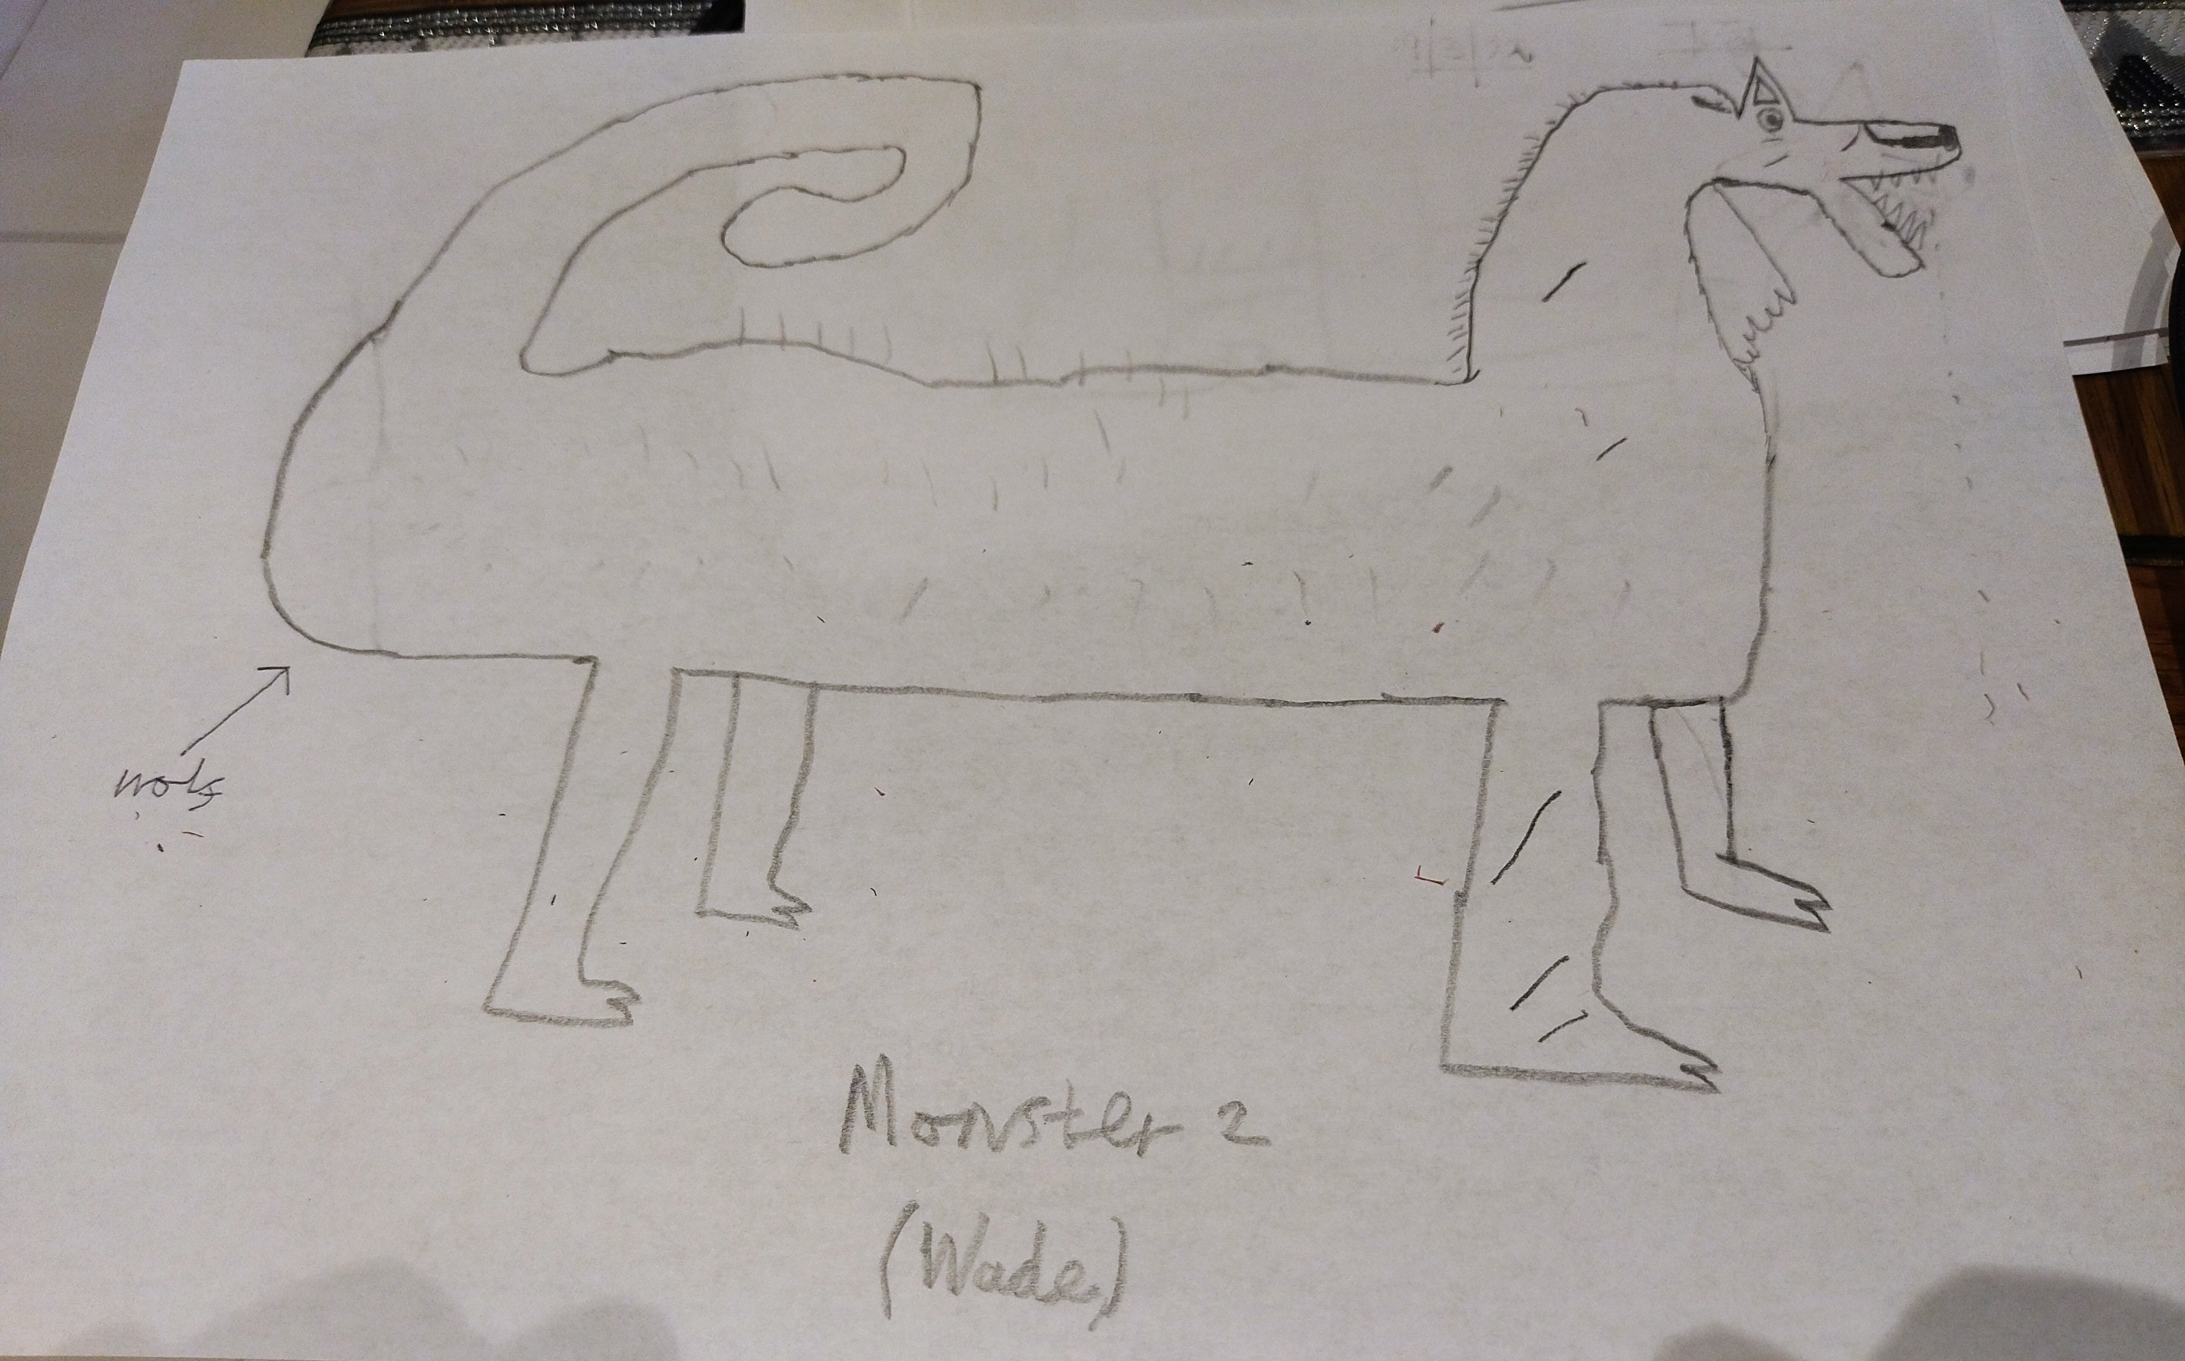
Monster Concept 1

Slide 48
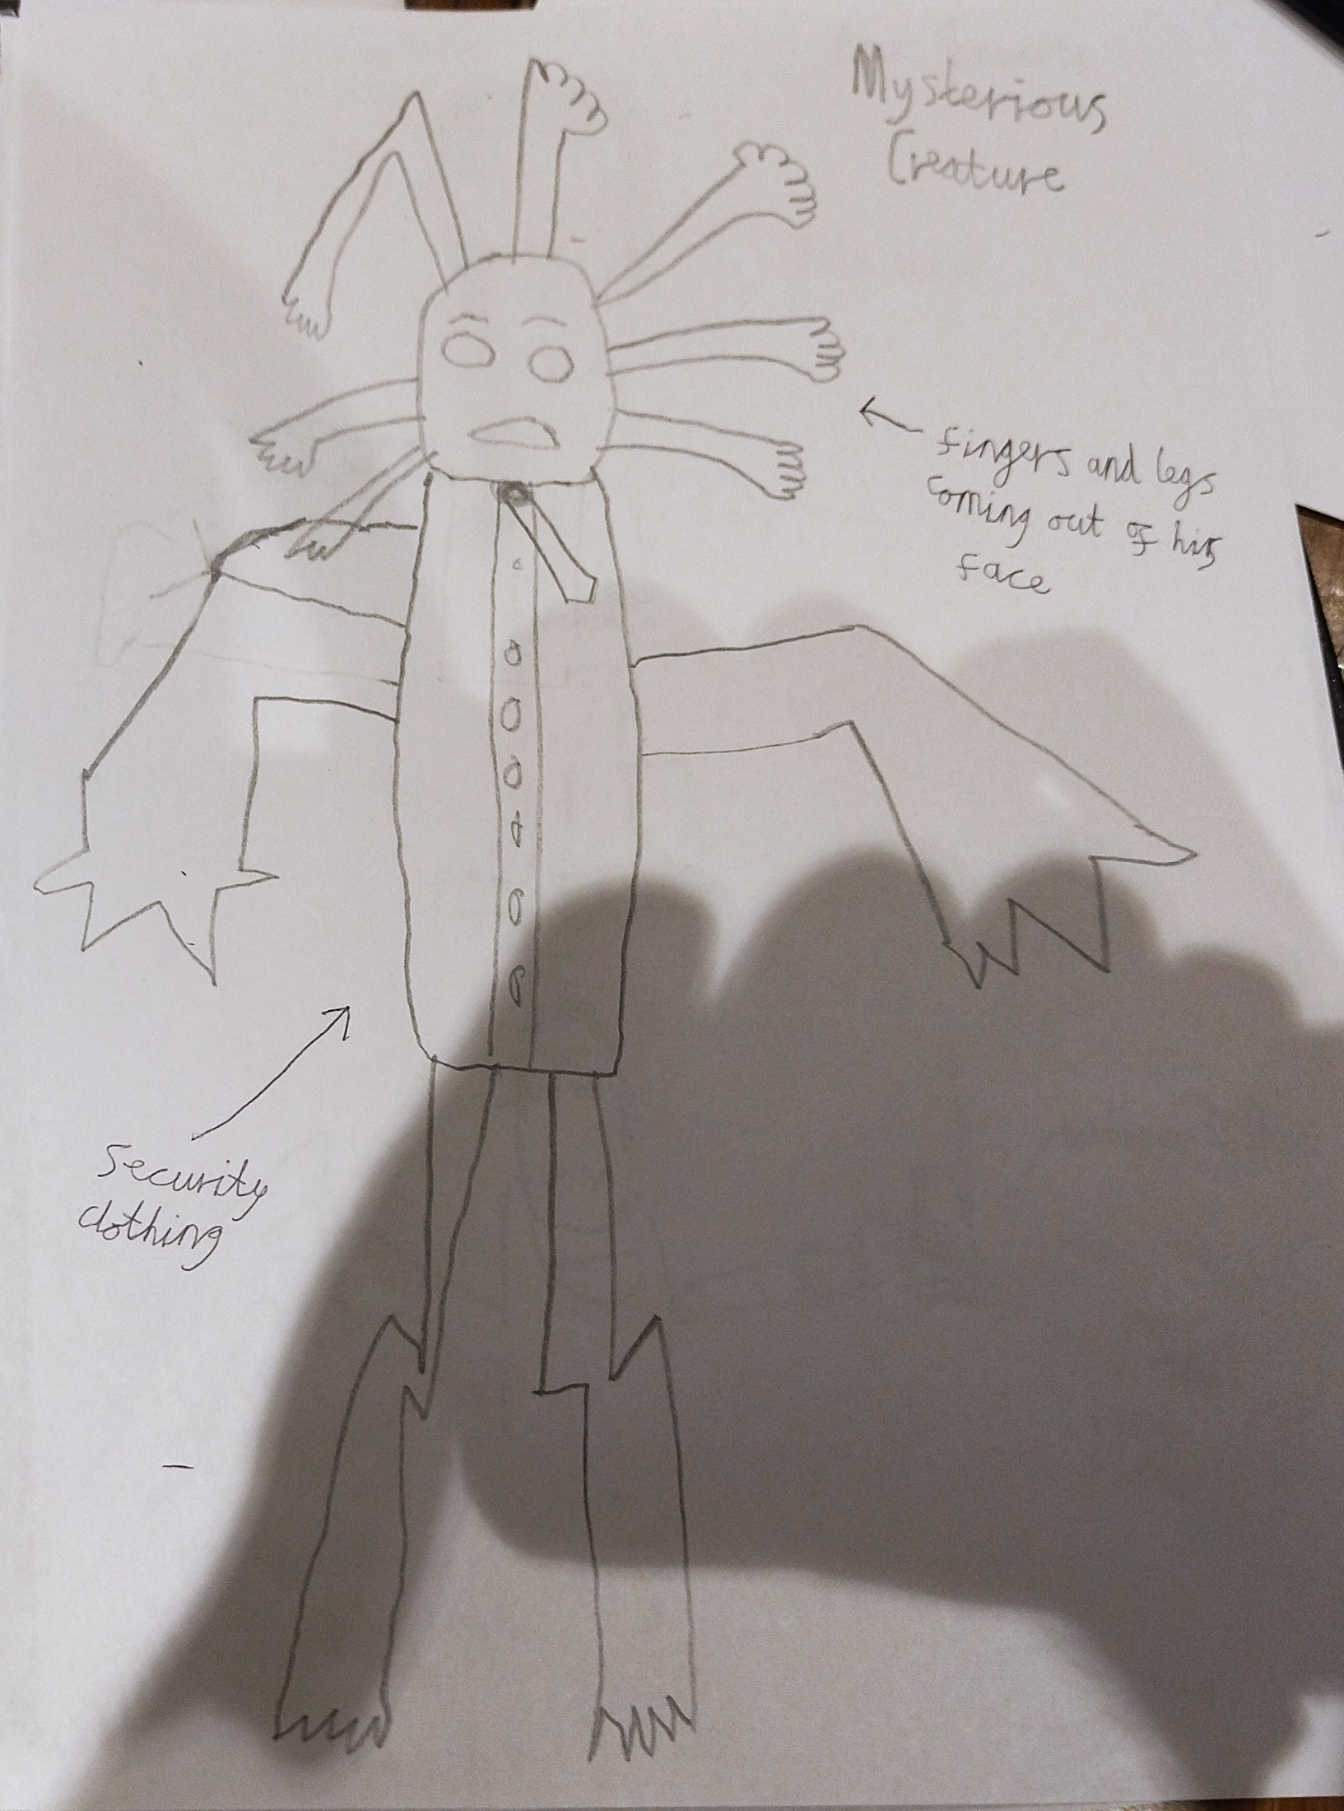
Monster Concept 2

Slide 49
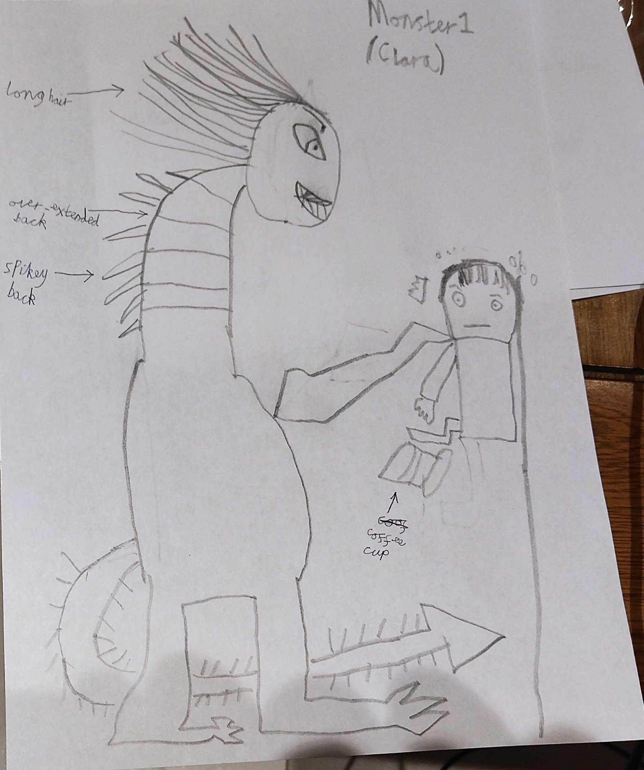
Monster Concept 3

Slide 50
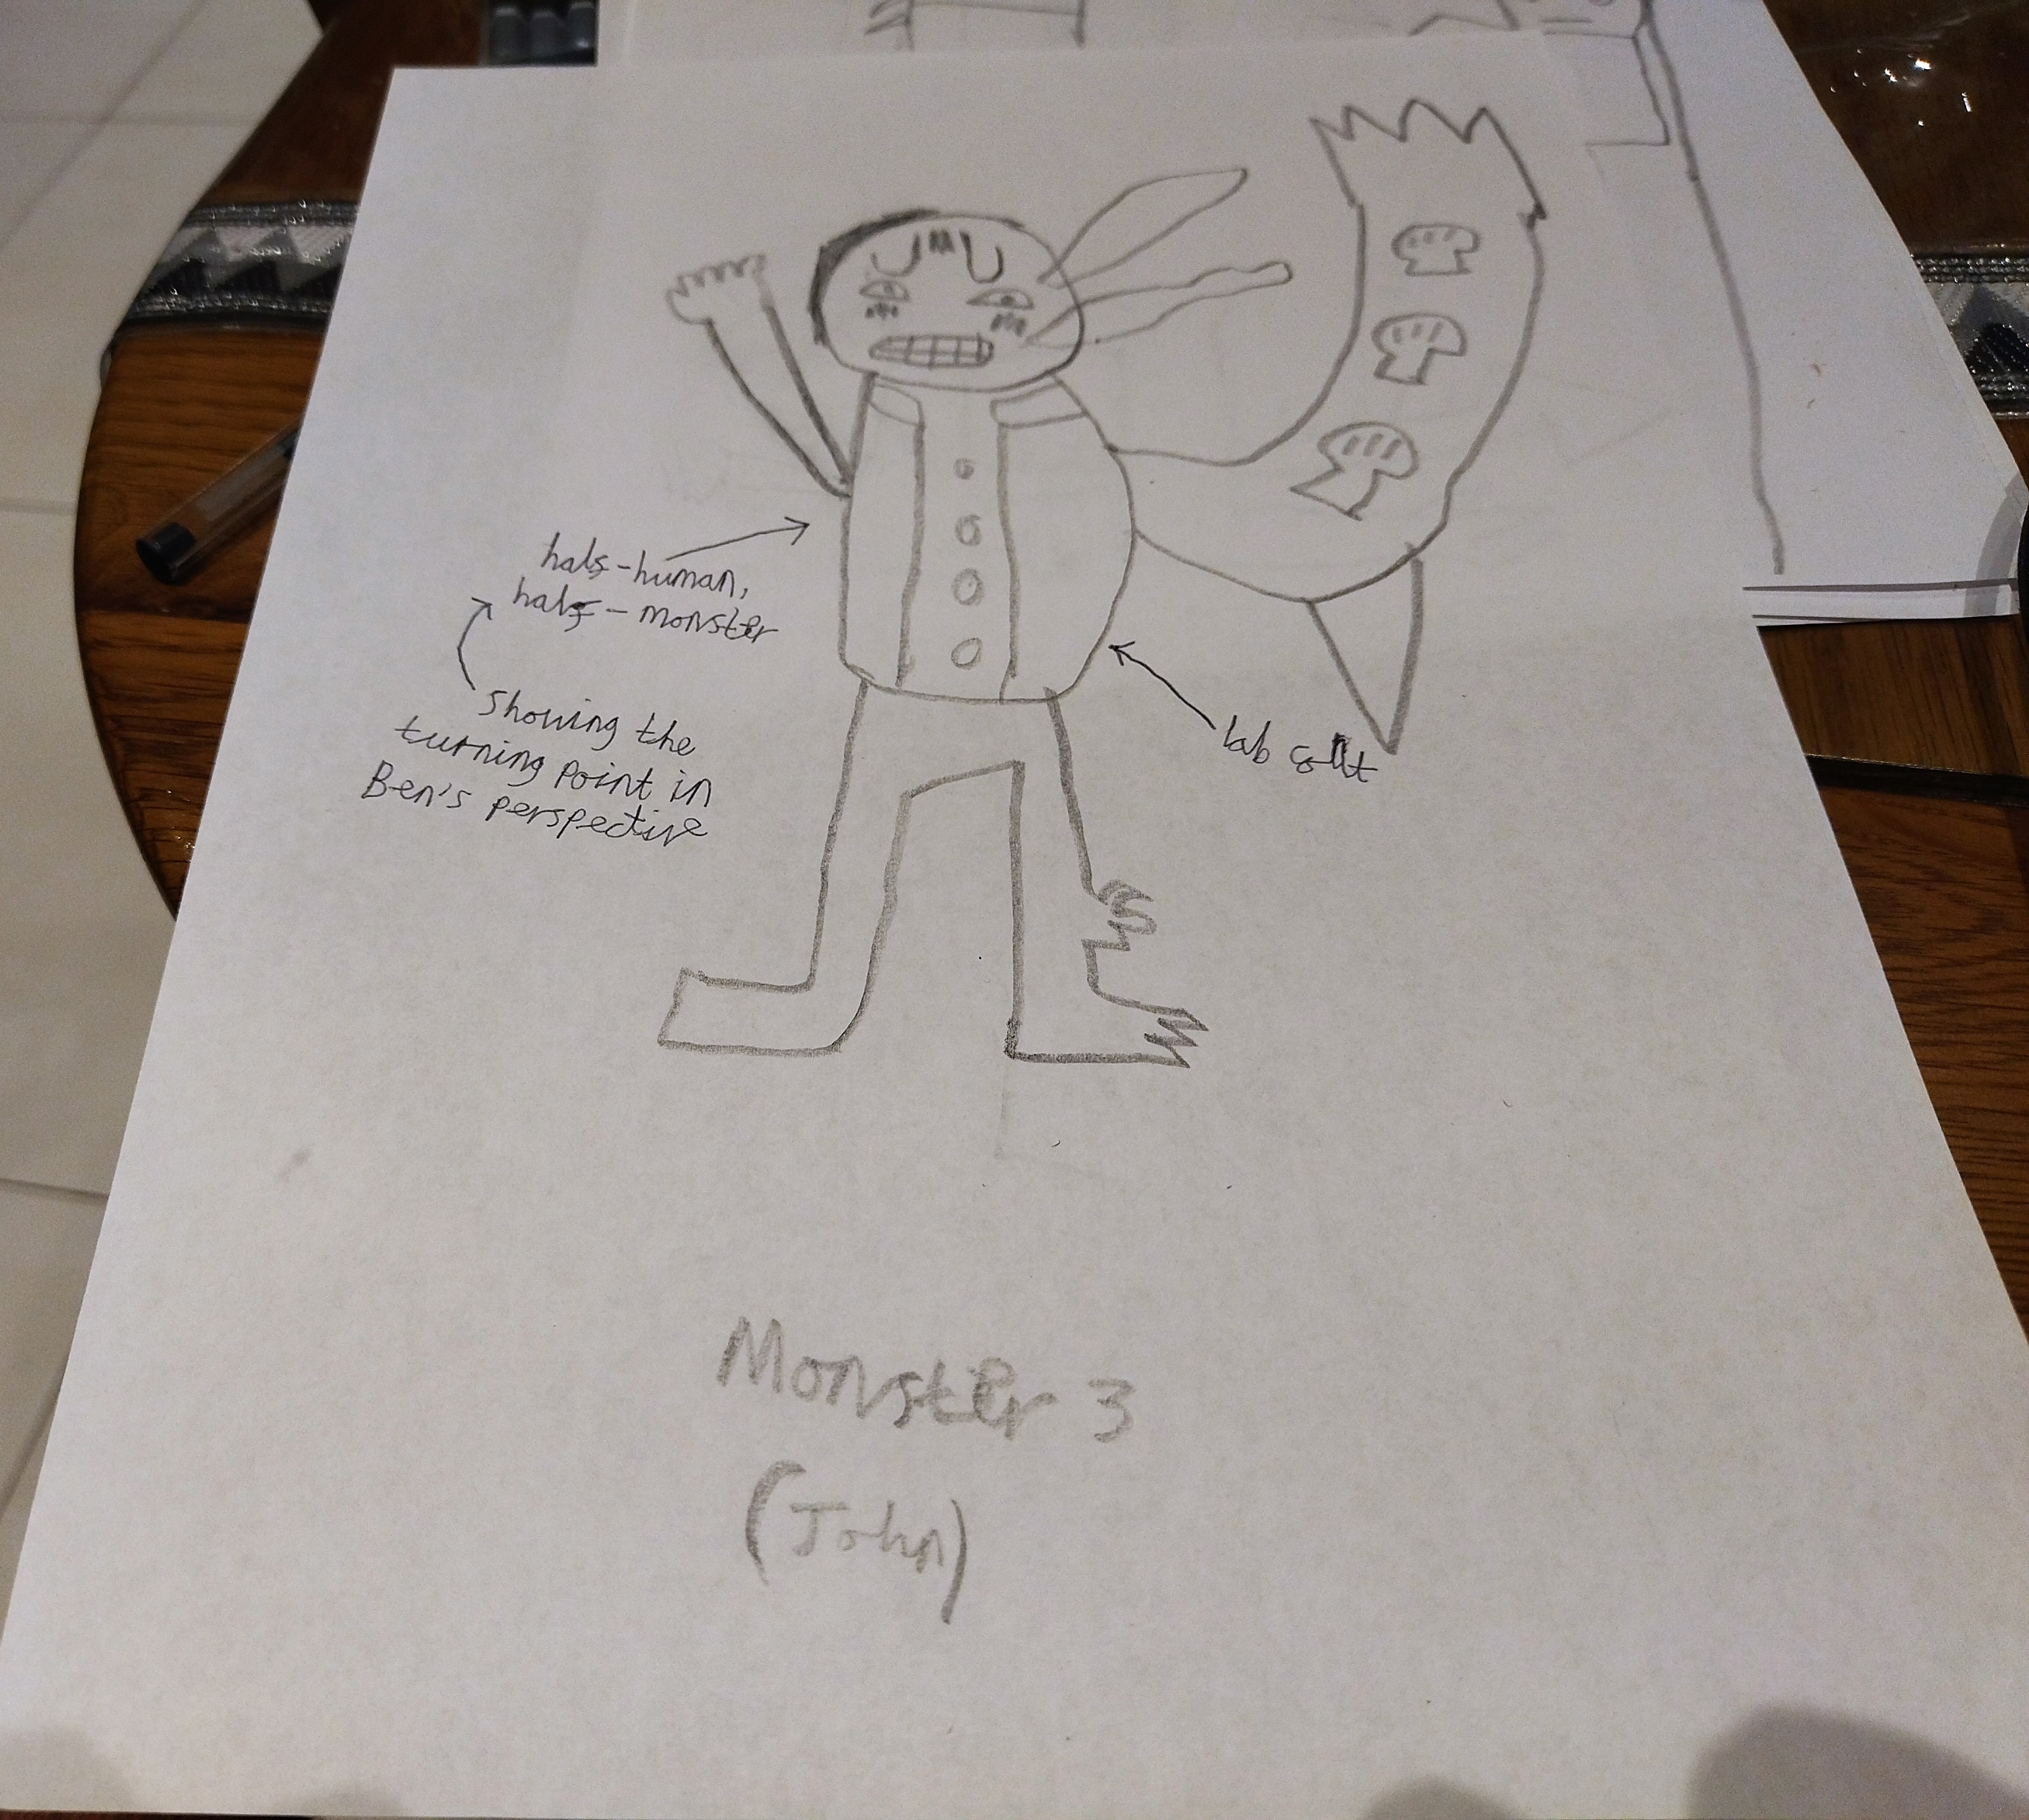
Monster Concept 4

Slide 51
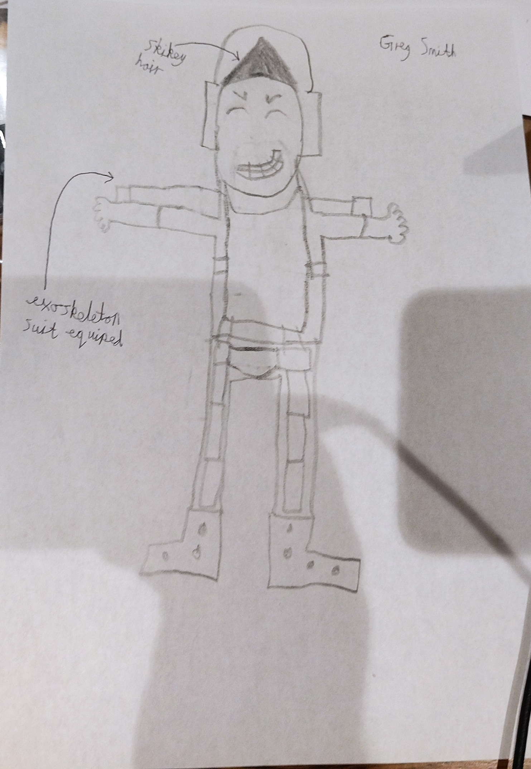
Greg’s Concept Design

Slide 52
Thank you for listening!

